Slide 1
CS331 · TEAM T005 · PROJECT 1
Minimal VPN
Tunnel
Aayush Kuloor - 24110004
Anvit Aggarwal - 24110048
Dhru Harsh Darshakbhai - 24110107
Raj Amit Modi - 24110282
Point-to-point IPv4 tunnel
Raspberry Pi 5 ↔ Raspberry Pi 5
Notes:
Introduce the project directly: a point-to-point IPv4 tunnel between two Raspberry Pi 5 systems. The presentation covers implementation, protocol design, validation, and measurements.
[Sources]
- README.md
- code/README.md
[/Sources]

Slide 2
OVERVIEW
System scope and design choices
Item | Choice | Reason / consequence
Inner network | 192.168.250.1/30 ↔ 192.168.250.2/30 | Host-to-host IPv4; no NAT or default-route change
Outer network | 10.7.51.1 ↔ 10.7.50.242 over Wi-Fi | Outer endpoints, sizes, timing and direction remain visible
Virtual interface | tun0 · IFF_TUN | IFF_NO_PI | Layer-3 packets only; no Ethernet header, ARP or MAC state
Transport | UDP/55555 | One inner packet per datagram; avoids TCP-over-TCP
TUN MTU | 1400 bytes | Encrypted outer IPv4 packet is at most 1472 bytes
Modes | plaintext / encrypted | Separates tunnel cost from incremental cryptographic cost
Cryptography | Ed25519 + crypto_kx + ChaCha20-Poly1305 | Pinned identity, fresh session keys, AEAD per DATA packet
· 02
Notes:
Use this table to set the exact scope. The tunnel handles arbitrary inner IPv4 traffic between two hosts. It does not act as an Internet gateway and does not claim to hide outer traffic metadata.
[Sources]
- code/README.md
- code/docs/architecture.md
- code/docs/protocol.md
[/Sources]

Slide 3
IMPLEMENTATION
System architecture
PI A · CLIENT
PI B · SERVER
Applications
ICMP · TCP · UDP
Applications
ICMP · TCP · UDP
Linux IPv4 routing
dst 192.168.250.2 → tun0
Linux IPv4 input / socket delivery
tun0 · 192.168.250.1/30 · MTU 1400
UNTRUSTED
WI-FI
tun0 · 192.168.250.2/30 · MTU 1400
svpn
poll(tun_fd, udp_fd)
protocol encode/decode · AEAD · replay state
svpn
peer/session checks · decrypt/authenticate
replay_check_update() · write_full(tun_fd)
UDP socket · 10.7.51.1:55555
UDP socket · 10.7.50.242:55555
wlan0
wlan0
· 03
Notes:
Follow the A-to-B path down Pi A, across Wi-Fi, and up Pi B. Linux selects tun0 from the inner destination. svpn uses one poll loop for the TUN and UDP file descriptors. Setup scripts own interface configuration; the process does not call sudo or modify routes or firewall state. The reverse data path is symmetric after the handshake.
[Sources]
- code/docs/architecture.md
- code/src/main.c
- code/src/tun.c
- code/src/udp.c
[/Sources]

Slide 4
IMPLEMENTATION
Packet processing inside svpn
Single-threaded event loop: poll() waits on tun_fd and udp_fd
TRANSMIT PATH
read(tun_fd)
seq + header
nonce_build()
aead_encrypt()
sendto()
RECEIVE PATH
recvfrom()
peer + header
session + AEAD
replay window
write_full(tun_fd)
DROP COUNTERS
wrong peer
malformed
wrong session
auth failure
replay
source IP/port mismatch
header/body/length failure
stale process/session
tag/AAD/key/nonce mismatch
duplicate or outside window
· 04
Notes:
The transmit path increments a 64-bit sequence and builds the header before optional AEAD. The receive path checks the configured peer, parses lengths, checks the session, authenticates, then updates replay state. Only authenticated non-replayed plaintext is written into tun0. Sequence exhaustion terminates the session instead of wrapping.
[Sources]
- code/src/main.c
- code/src/protocol.c
- code/src/replay.c
[/Sources]

Slide 5
Wire format and MTU calculation
Offset | Bytes | Field | Validation
0 | 4 | magic = SVPN | exact match
4 | 1 | version = 1 | reject other versions
5 | 1 | type | CHLO / SHLO / DATA / CLOSE
6 | 2 | flags | must be zero
8 | 8 | session_id | must match encrypted session
16 | 8 | sequence | big-endian; starts at 1
24 | 2 | plaintext_len | 1–1400 for DATA
26 | 2 | reserved | must be zero
ENCRYPTED DATA DATAGRAM
Header
28 B AAD
Inner IP ciphertext
plaintext_len B
Tag
16 B
Body length must be exact. Zero-length DATA, payloads above 1400 bytes, and trailing bytes are rejected.
OUTER IPv4 SIZE AT MAXIMUM INNER MTU
1400 + 28 + 16 + 8 + 20 = 1472 bytes
1472 < 1500, so the tunnel does not rely on outer IPv4 fragmentation.
All multi-byte integers are encoded explicitly in network byte order.
· 05
Notes:
The common header is exactly 28 bytes. The parser uses explicit offsets and lengths rather than serializing a C struct. In encrypted DATA, the header is AAD, the inner packet is ciphertext, and libsodium appends a 16-byte tag. At the 1400-byte TUN MTU, the complete outer IPv4 packet is 1472 bytes.
[Sources]
- code/docs/protocol.md
- code/src/protocol.c
- code/include/common.h
[/Sources]

Slide 6
Authenticated ephemeral key exchange
Pi A · client
Pi B · server
CLIENT_HELLO · 112-byte payload
client ephemeral pk (32) | client_random (16) | Ed25519 signature (64)
signature transcript: "SVPN-CHLO-v1" || version || client_random || client_eph_pk
SERVER_HELLO · 128-byte payload
server ephemeral pk (32) | echoed client_random (16) | server_random (16) | signature (64)
crypto_kx: client_tx = server_rx · client_rx = server_tx
CLIENT_HELLO retransmit: 500 ms · handshake timeout: 10 s · duplicate CHLO receives the same SHLO
· 06
Notes:
Each process creates a fresh crypto_kx keypair. Long-term Ed25519 keys sign explicit transcripts and are verified against the pinned peer public key. The server echoes the client random, both sides compute the same session ID, and crypto_kx produces separate keys for each direction. Handshake messages are retransmitted because DATA itself has no tunnel-level reliability.
[Sources]
- code/docs/protocol.md
- code/src/handshake.c
- code/src/crypto.c
[/Sources]

Slide 7
TESTING
Verification coverage
Layer | Cases covered | Result
Protocol parser | Exact bytes; big-endian sequence; invalid magic/version/type; lengths 0–27; trailing/oversize; random buffers | pass
Crypto | Directional crypto_kx keys; nonce domains; AEAD at 0, 4 and 1400 B; tampered ciphertext/tag/AAD/key/nonce | pass
Handshake | Valid CHLO/SHLO; modified ephemeral/random; wrong pinned identity; echoed random; matching session IDs | pass
Replay | First/monotonic; duplicate; in-window reorder; highest−63 boundary; ≥64 jump; UINT64_MAX; sequence 0 | pass
Integration | Plaintext and encrypted ping/TCP/UDP; session establishment; wrong-identity negative test | pass
Memory safety | AddressSanitizer + UndefinedBehaviorSanitizer on both Raspberry Pis | pass
Capture | Marker visible on tun0; absent on encrypted wlan0; visible on plaintext wlan0 control | pass
· 07
Notes:
The assertion count is not the main point; the matrix shows what was exercised. Parser fuzz-like inputs, cryptographic tampering, handshake identity failures, and replay edge conditions are unit tested. The same code was then exercised end-to-end on the two-Pi testbed.
[Sources]
- code/docs/testing.md
- more_docs/analysis.md
- code/tests/test_protocol.c
- code/tests/test_crypto.c
- code/tests/test_handshake.c
- code/tests/test_replay.c
[/Sources]

Slide 8
TESTING
Packet-capture evidence
Capture | Interface / mode | Bytes | SVPN magic | HTTP marker | Interpretation
encrypted_tun0.pcap | tun0 / encrypted | 1,018 | n/a | present | Inner packet is plaintext at the virtual interface
encrypted_wlan0.pcap | wlan0 / encrypted | 1,878 | present | absent | Header visible as AAD; inner IP and HTTP body encrypted
plaintext_wlan0.pcap | wlan0 / plaintext | 1,718 | present | present | Control confirms the marker is observable without AEAD
Visible metadata on encrypted wlan0
10.7.51.1 ↔ 10.7.50.242
UDP/55555 · lengths · timing · direction
· 08
Notes:
The marker appears in the inner capture and the plaintext outer control, but not in the encrypted outer capture. The SVPN magic remains visible because the common header is authenticated as AAD rather than encrypted. This is evidence for inner-payload confidentiality only.
[Sources]
- more_docs/analysis.md
- code/scripts/capture_demo.sh
- code/captures/encrypted_tun0.pcap
- code/captures/encrypted_wlan0.pcap
- code/captures/plaintext_wlan0.pcap
[/Sources]

Slide 9
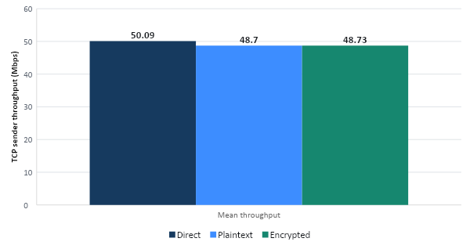
PERFORMANCE
A → B encrypted TCP: 48.73 Mbps
TCP SENDER THROUGHPUT · MEAN ± SAMPLE SD
MEASURED VALUES
Direct
50.09 ± 4.54 Mbps
Plaintext tunnel
48.70 ± 6.51 Mbps
Encrypted tunnel
48.73 ± 3.61 Mbps
Encrypted and plaintext means differ by only 0.03 Mbps.
Authenticated encryption adds 4.99 pp CPU on Pi A and 5.13 pp on Pi B.
The encrypted tunnel maintains the plaintext throughput level while adding authentication, confidentiality and replay protection.
09
Notes:
The two grouped campaigns show about 7 percent incremental crypto cost in A-to-B TCP. In the interleaved campaign, direct and encrypted means are effectively identical while process CPU still increases by about five percentage points on each Pi. That stable CPU delta is stronger evidence of cryptographic cost than the variable Mbps gap.
[Sources]
- code/results/20260828-182523/summary.md
- code/results/20260828-192034/summary.md
- code/results/20260828-203143/summary.md
- more_docs/analysis.md
[/Sources]

Slide 10
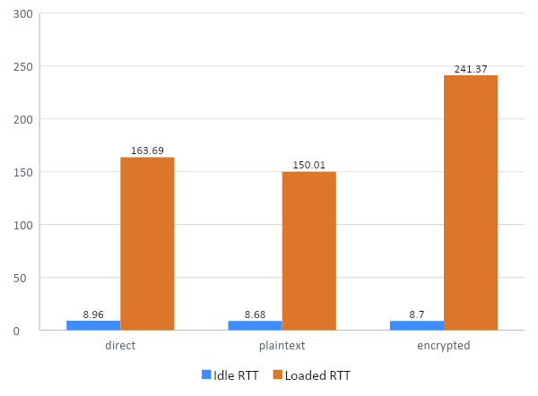
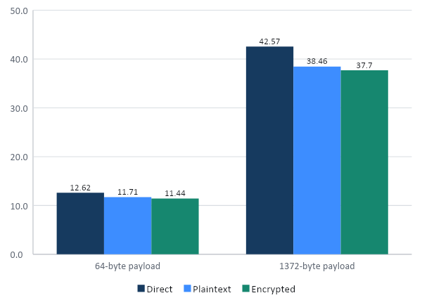
PACKET EXPERIMENTS
Encrypted performance under load
A → B RTT UNDER TCP LOAD
UDP MAX-EFFORT RECEIVE GOODPUT
Encrypted mode sustains 44.77 ± 4.89 Mbps TCP under load and 37.70 Mbps UDP at 1372 bytes; idle RTT remains 8.70 ± 0.13 ms.
14
Notes:
The loaded-latency experiment is noisy but shows strong queueing on the shared access point. The max-effort UDP table separates packet-rate and bit-rate limits. Tiny datagrams plateau near 23 to 25 thousand packets per second. Large datagrams reach 38 to 43 Mbps receive goodput at this high offer, with the access point dropping a large fraction in every mode.
[Sources]
- code/results/20260830-121636-packet/summary.md
- more_docs/analysis.md
[/Sources]

Slide 11
CONCLUSION
Summary and future work
MEASURED RESULT
FUTURE WORK
45–55 Mbps
Typical encrypted TCP throughput across both directions
Multiple peers and route management
Session rekeying and key rotation
Privilege separation / capability reduction
Batching with recvmmsg()/sendmmsg()
Rate control and queue management
Metadata-hiding mechanisms
≤0.5% loss
Encrypted UDP from 128 to 1372 bytes at a 20 Mbps offer
9–11 ms
Encrypted idle RTT across supported ICMP payload sizes
The design combines authenticated ephemeral key exchange, per-packet AEAD, replay protection and practical Raspberry Pi throughput.
11
Notes:
End with the exact claims supported by the implementation and measurements. The tunnel establishes an authenticated session, protects and replay-checks each DATA packet, and forwards real IP traffic. The main engineering limitations are session lifecycle, scaling beyond two peers, process hardening, packet batching, queue control, and traffic metadata.
[Sources]
- code/README.md
- more_docs/analysis.md
- code/results/20260828-203143/summary.md
- code/results/20260830-121636-packet/summary.md
[/Sources]

